Slide 2
A Short Intro: 无处不在的对抗样本攻防
张志博
扇贝算法团队负责人

Slide 3
无处不在的对抗样本攻防
What is an Adversarial Example? 矛与盾（常见攻击和防御算法）
新的趋势和风险
01
02
03

Slide 4
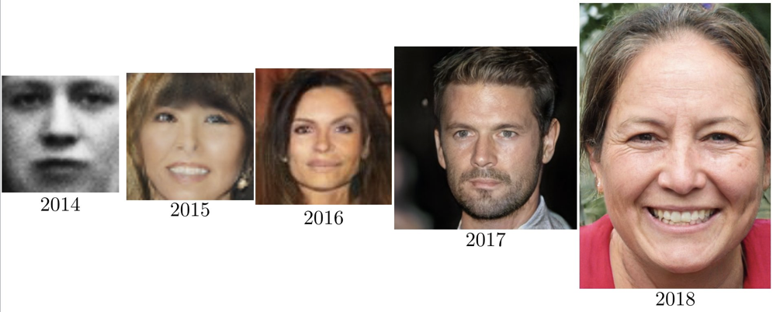
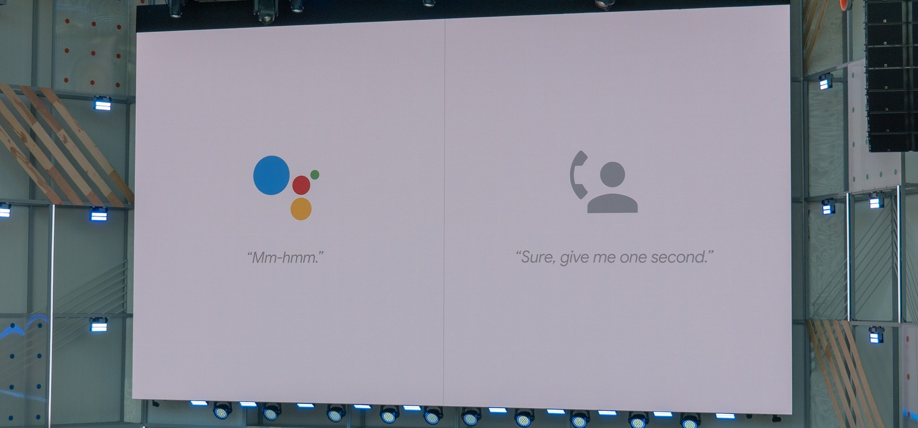
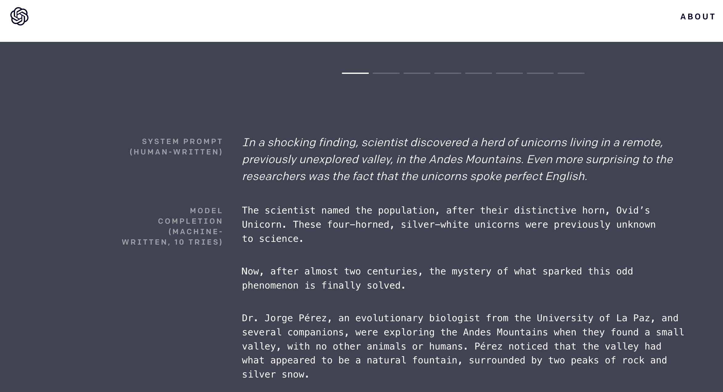
StyleGAN(2018)
Tacotron(2017)
GPT-2(2019)
深度学习模型生成结果已经可以欺骗人类，那么模型可以被欺骗吗？

Slide 5
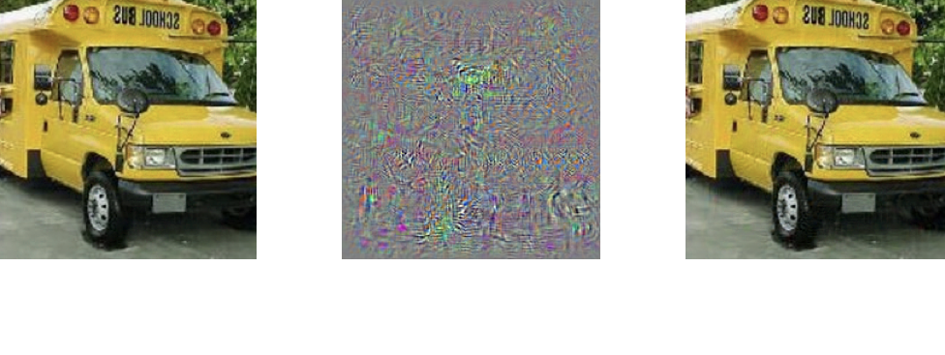
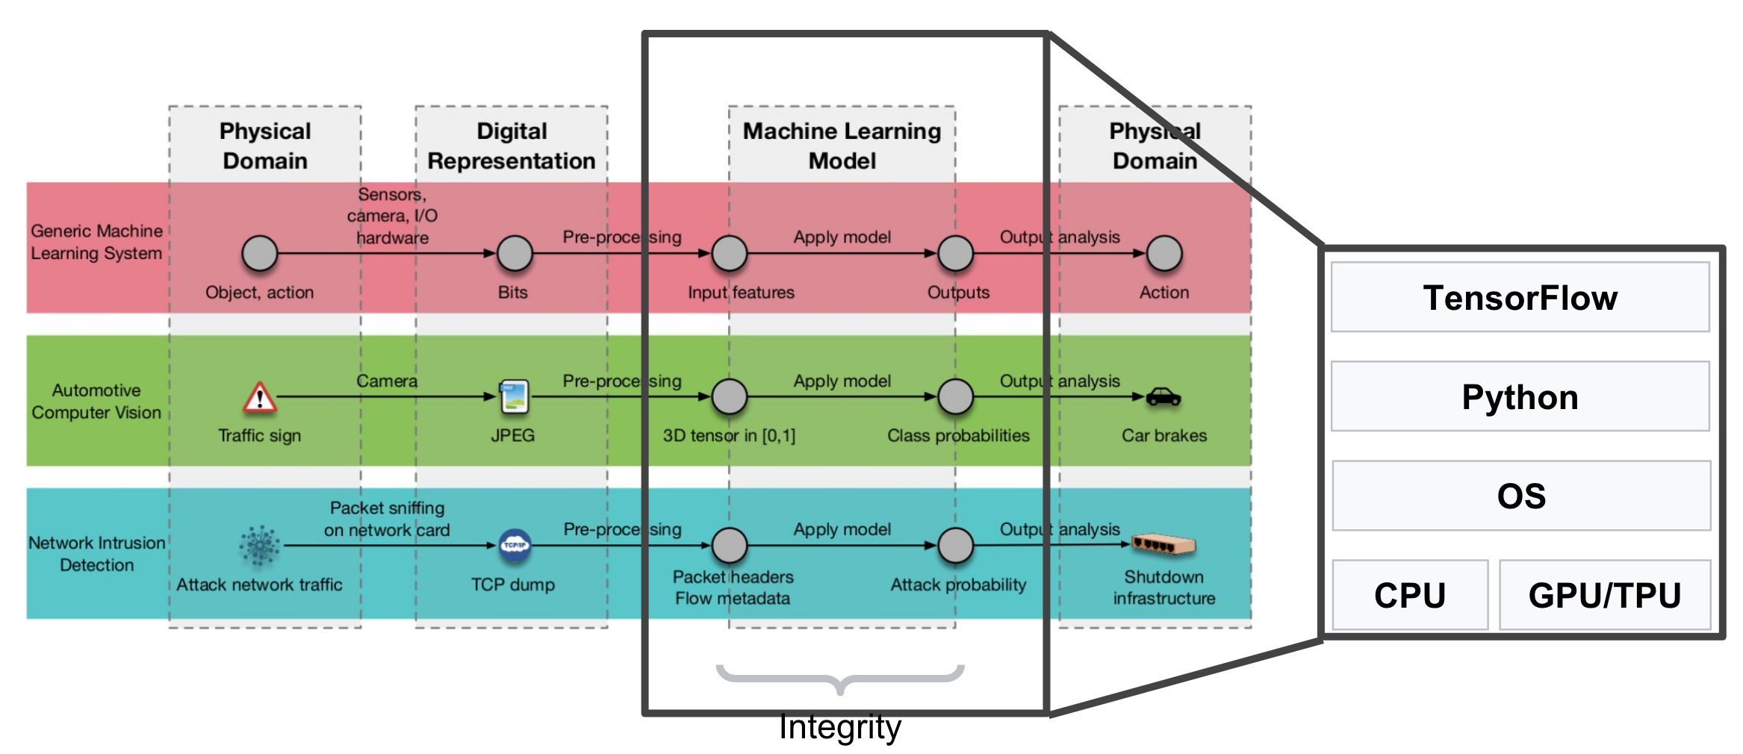
What is an Adversarial Example(对抗样本)?
Inputs that have been intentionally designed to cause a model to make a mistake
They’re like optical illusions for machines.

Slide 6
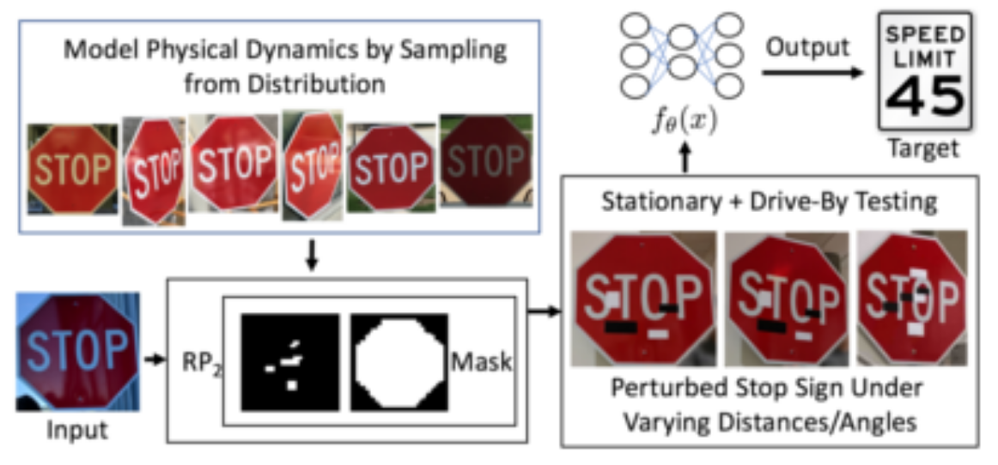
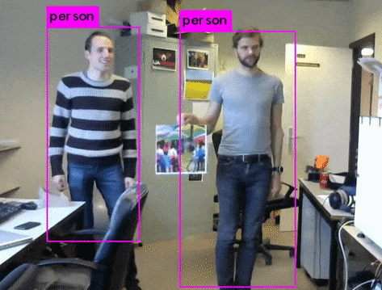
Adversarial Glasses
Adversarial Stop Sign
Adversarial Patch

Slide 7
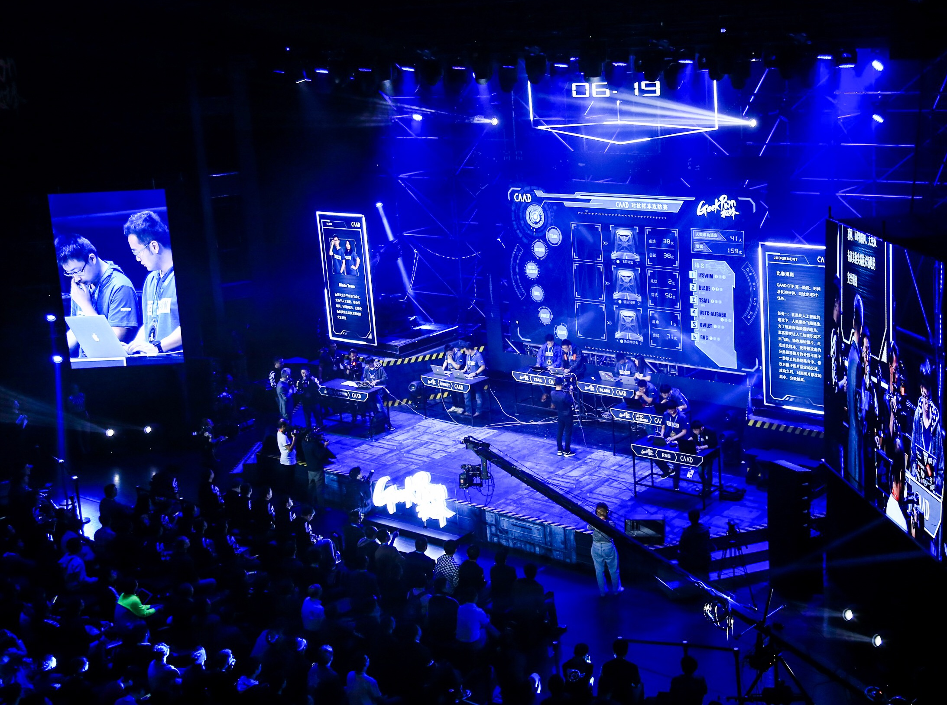
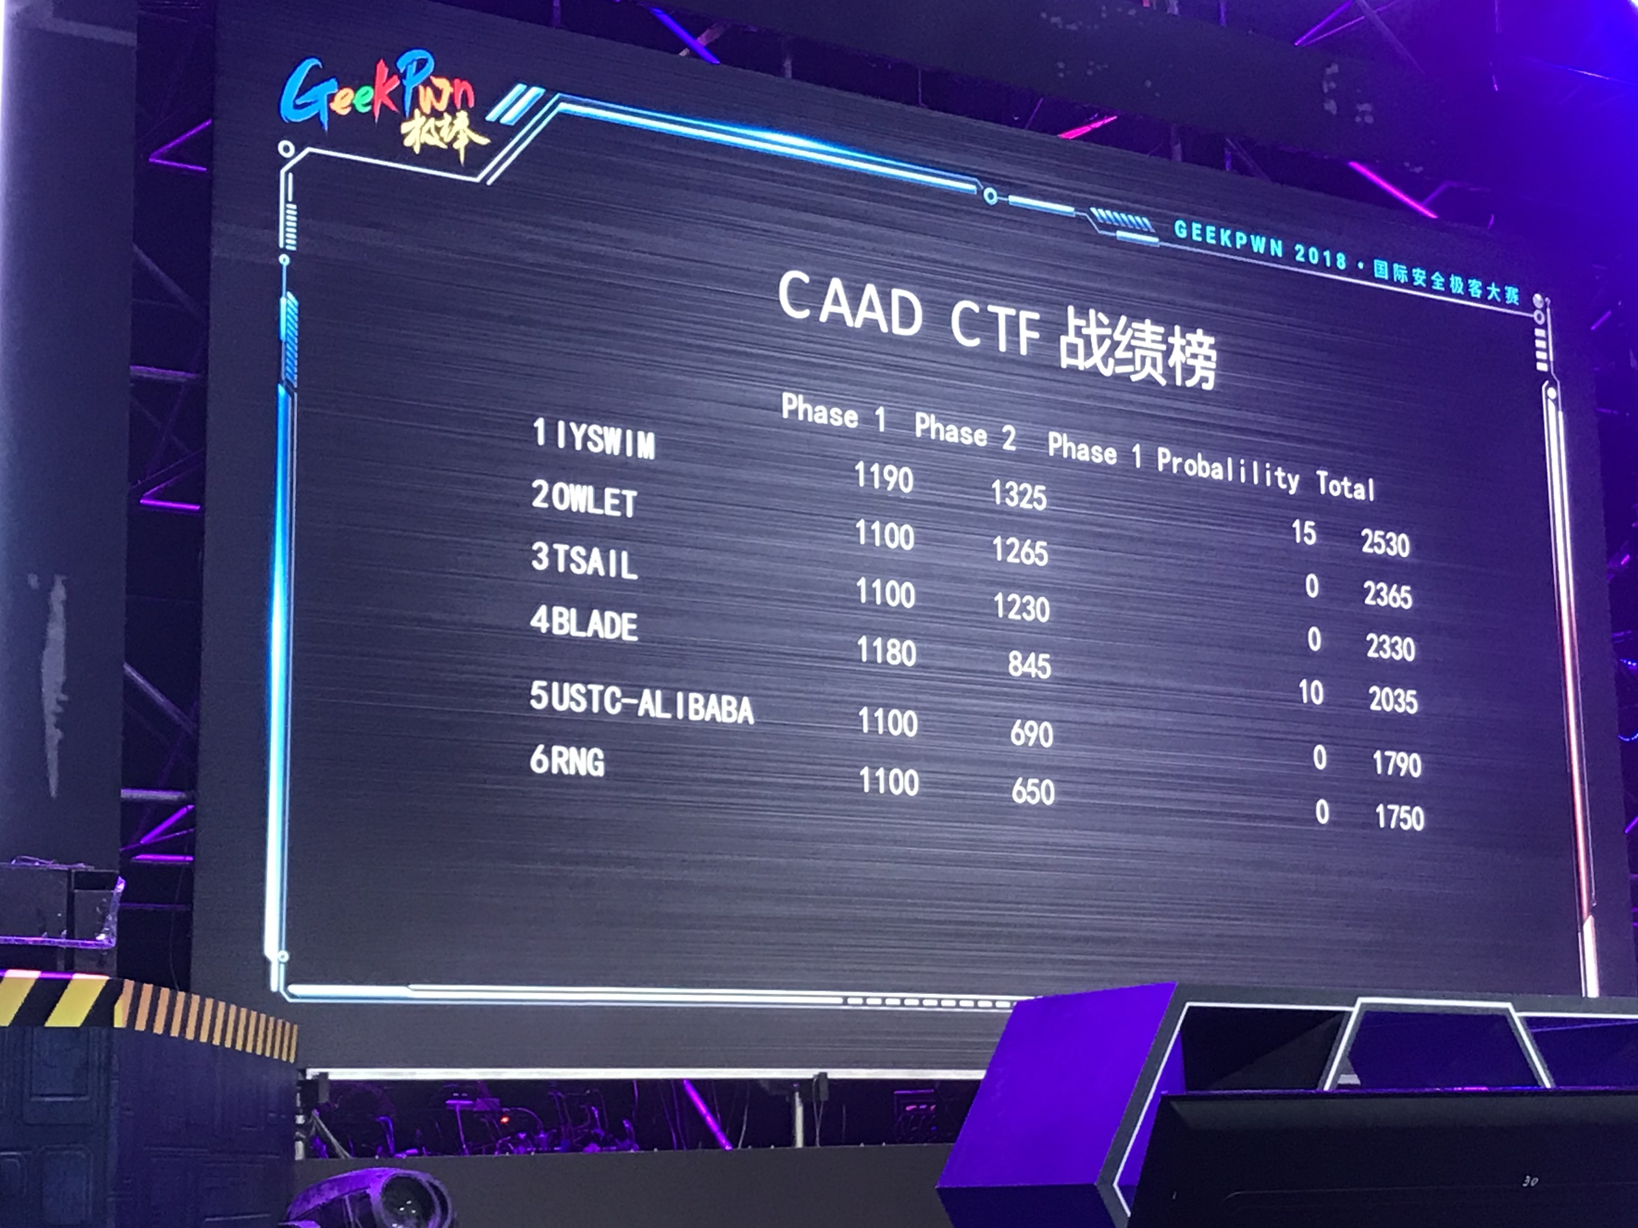
Competition on Adversarial Attacks and Defenses 2018
Ian Goodfellow (Google Brain) , Alexey Kurakin (Google Brain), Dawn Song (UC Berkeley), GeekPwn

Slide 8
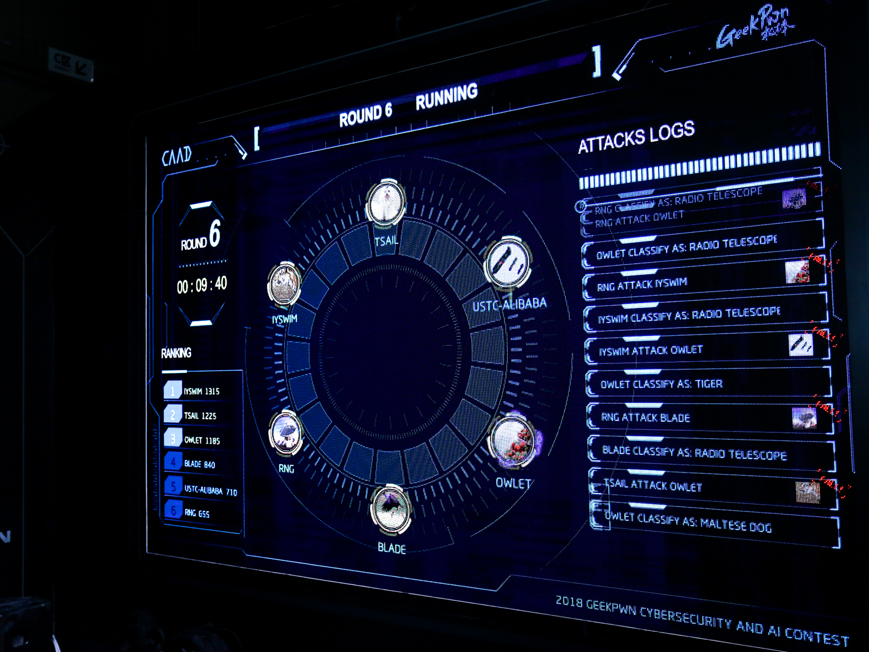
CAAD CTF Ruleset
Non-Targeted Adversarial Attack (非定向攻击)
Slightly modify source image in a way that image will be classified incorrectly by generally unknown classifier.
Targeted Adversarial Attack (定向攻击)
Slightly modify source image in a way that image will be classified as specified target class by generally unknown classifier.
Defense Against Adversarial Attack

Slide 9
无处不在的对抗样本攻防
What is an Adversarial Example? 矛与盾（常见攻击和防御算法）
新的趋势和风险
01
02
03

Slide 10
Example Attack Scenarios
FGSM (Fast Gradient Sign Method)
BIM (Basic Iterative Method)
MIM(Momentum Iterative FGSM)
ATN(Adversarial Transformation Networks)

Slide 11
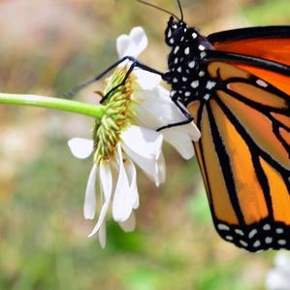
Fun Results (transferability)
Butterfly
Rabbit

Slide 12
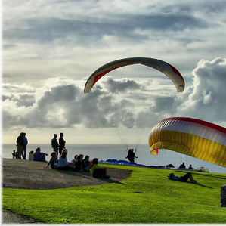
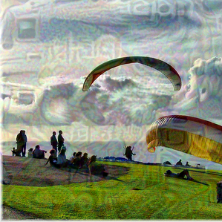
Fun Results (transferability)
parachute
vehicle

Slide 13
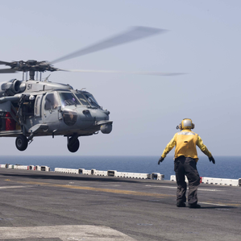
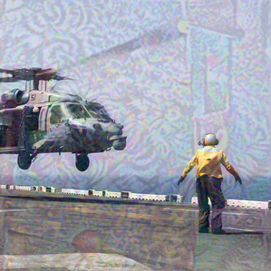
Fun Results (transferability)
aircraft carrier
guillotine

Slide 14
Example Defense Scenarios
Gradient masking
Detection
Image processing and randomization
Adversarial training

Slide 15
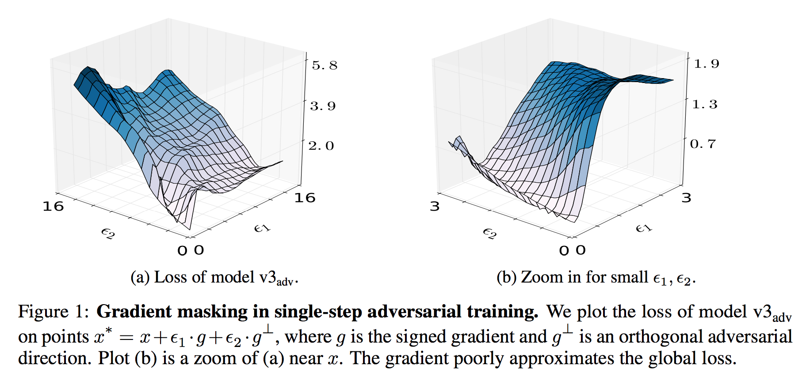
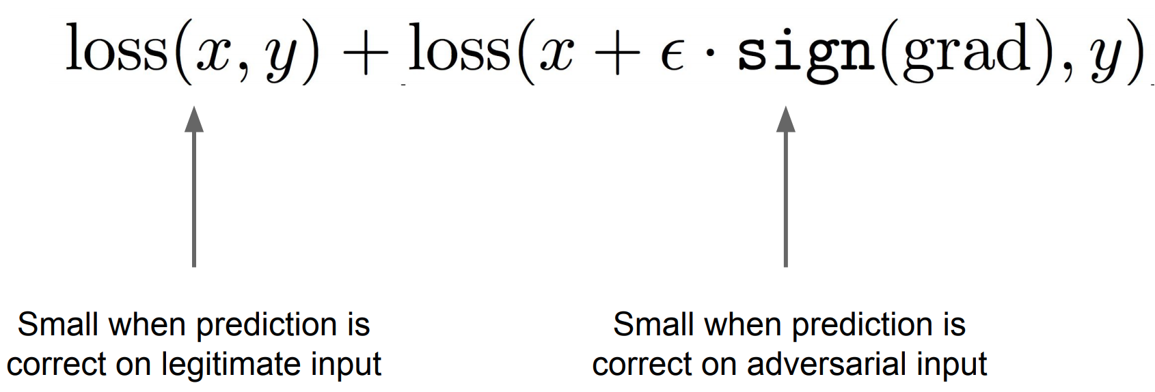
Gradient Masking
Construct a model that does not have useful gradients[24]
They break gradient-based white box attacks. But then they don’t break black box attacks (e.g., adversarial examples made for other models)
[24]Papernot, Nicolas, et al. "Practical black-box attacks against machine learning." Proceedings of the 2017 ACM on Asia Conference on Computer and Communications Security. ACM, 2017.

Slide 16
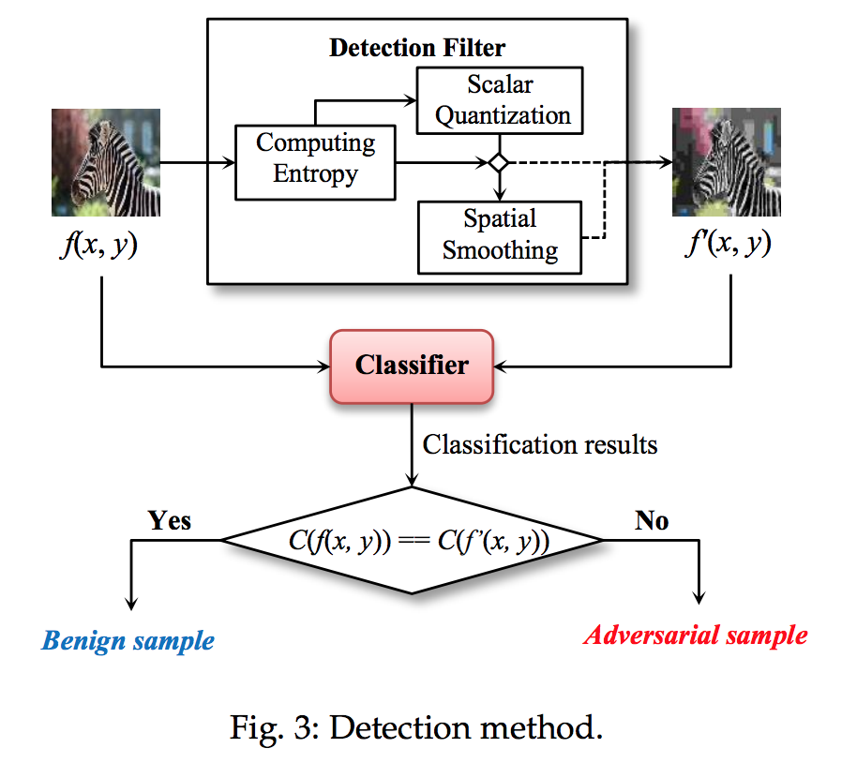
Detection

Slide 17
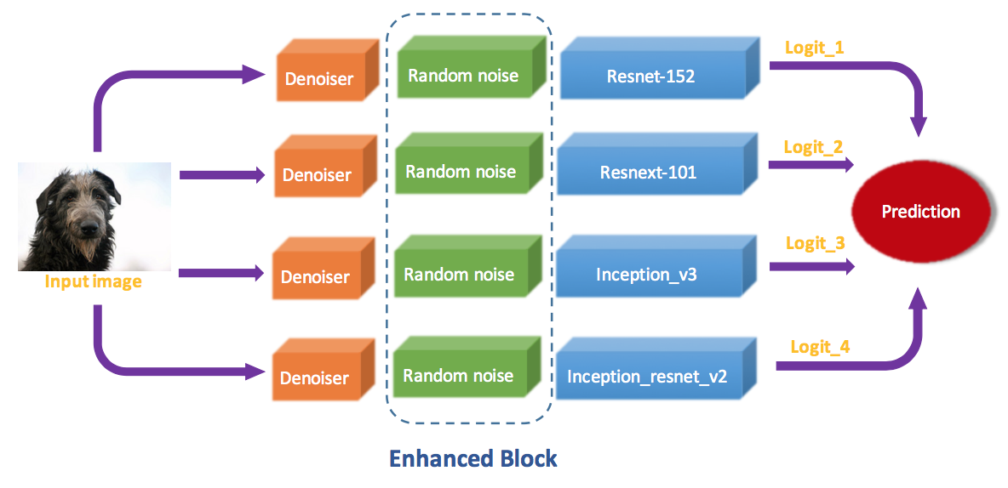
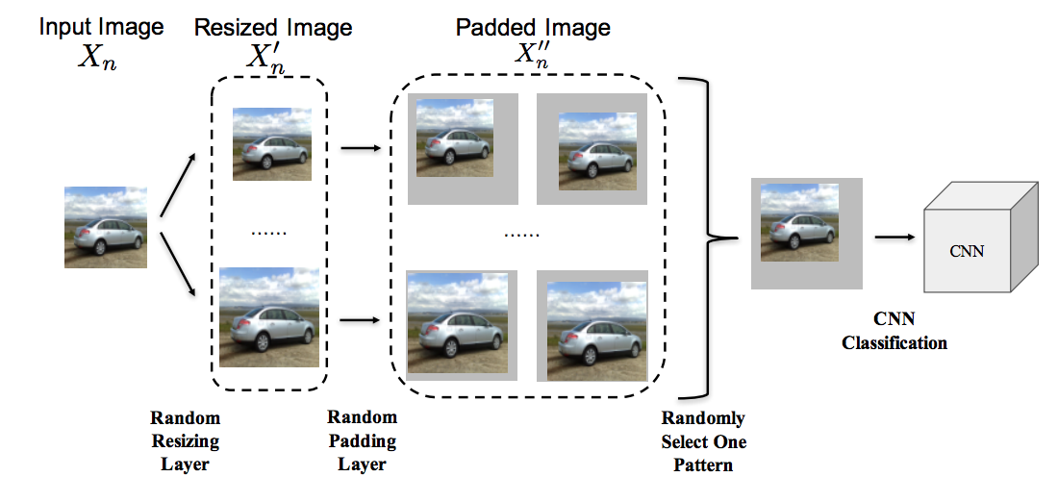
Image processing and randomization

Slide 18
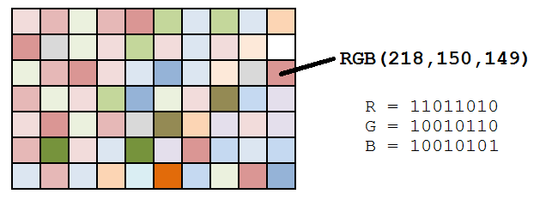
Image processing and randomization
2 most significant bits
== quantification

Slide 19
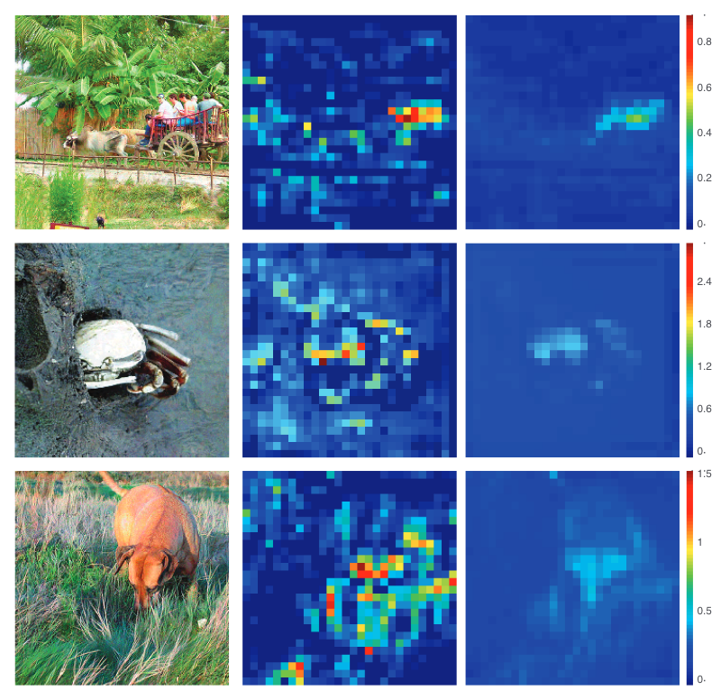
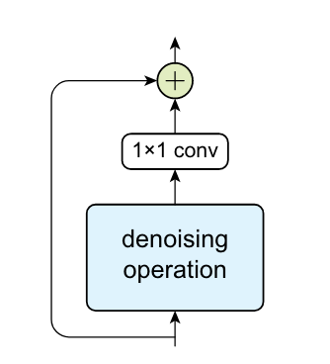
Adversarial Training
Augments a model’s training data with adversarial examples crafted on other static pre-trained models [10]
Adversarial logit paring
Feature Denoising (128 Nvidia V100 GPUs, 52 hours for Imagenet)
[10]F. Tramèr, A. Kurakin, N. Papernot, I. Goodfellow, D. Boneh, and P. McDaniel, “Ensemble Adversarial Training: Attacks and Defenses,” arXiv:1705.07204 [cs, stat], May 2017.

Slide 20
无处不在的对抗样本攻防
What is an Adversarial Example? 矛与盾（常见攻击和防御算法）
新的趋势和风险
01
02
03

Slide 21
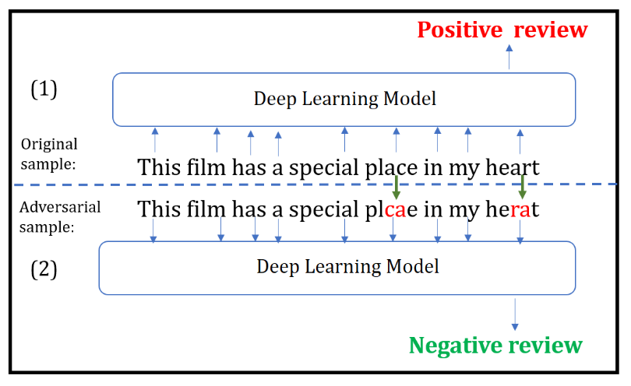
Imperceptible, Robust, and Targeted Adversarial Examples for Automatic Speech Recognition
“研表究明，汉字的序顺并不定一能影阅响读，比如当你看完这句话后，才发这现里的字全是乱的。”

Slide 22
Ref
Authors: Ian Goodfellow, Kaiming He, Jun Zhu
Conferences: NIPS, ICML, CVPR
Toolkits: CleverHans, AdvBox, adversarial-robustness-toolbox

Slide 23
[1]I. J. Goodfellow, J. Shlens, and C. Szegedy, “Explaining and Harnessing Adversarial Examples,” arXiv:1412.6572 [cs, stat], Dec. 2014.
[2]A. Kurakin, I. Goodfellow, and S. Bengio, “Adversarial examples in the physical world,” arXiv:1607.02533 [cs, stat], Jul. 2016.
[3]N. Papernot et al., “CleverHans v2.1.0: an adversarial machine learning library,” arXiv:1610.00768 [cs, stat], Oct. 2016.
[4]S. Baluja and I. Fischer, “Adversarial Transformation Networks: Learning to Generate Adversarial Examples,” arXiv:1703.09387 [cs], Mar. 2017.
[5]Y. Dong et al., “Boosting Adversarial Attacks with Momentum,” arXiv:1710.06081 [cs, stat], Oct. 2017.
[6]C. Guo, M. Rana, M. Cisse, and L. van der Maaten, “Countering Adversarial Images using Input Transformations,” arXiv:1711.00117 [cs], Oct. 2017.
[7]J. Hayes and G. Danezis, “Learning Universal Adversarial Perturbations with Generative Models,” arXiv:1708.05207 [cs, stat], Aug. 2017.
[8]F. Liao, M. Liang, Y. Dong, T. Pang, X. Hu, and J. Zhu, “Defense against Adversarial Attacks Using High-Level Representation Guided Denoiser,” arXiv:1712.02976 [cs], Dec. 2017.
[9]T. Pang, C. Du, Y. Dong, and J. Zhu, “Towards Robust Detection of Adversarial Examples,” arXiv:1706.00633 [cs], Jun. 2017.
[10]F. Tramèr, A. Kurakin, N. Papernot, I. Goodfellow, D. Boneh, and P. McDaniel, “Ensemble Adversarial Training: Attacks and Defenses,” arXiv:1705.07204 [cs, stat], May 2017.
[11]C. Xie, J. Wang, Z. Zhang, Z. Ren, and A. Yuille, “Mitigating Adversarial Effects Through Randomization,” arXiv:1711.01991 [cs], Nov. 2017.
[12]A. Athalye, N. Carlini, and D. Wagner, “Obfuscated Gradients Give a False Sense of Security: Circumventing Defenses to Adversarial Examples,” arXiv:1802.00420 [cs], Feb. 2018.
[13]G. F. Elsayed et al., “Adversarial Examples that Fool both Computer Vision and Time-Limited Humans,” arXiv:1802.08195 [cs, q-bio, stat], Feb. 2018.
[14]J. Gilmer, R. P. Adams, I. Goodfellow, D. Andersen, and G. E. Dahl, “Motivating the Rules of the Game for Adversarial Example Research,” arXiv:1807.06732 [cs, stat], Jul. 2018.
[15]H. Kannan, A. Kurakin, and I. Goodfellow, “Adversarial Logit Pairing,” arXiv:1803.06373 [cs, stat], Mar. 2018.
[16]A. Kurakin et al., “Adversarial Attacks and Defences Competition,” arXiv:1804.00097 [cs, stat], Mar. 2018.
[17]M.-I. Nicolae et al., “Adversarial Robustness Toolbox v0.3.0,” arXiv:1807.01069 [cs, stat], Jul. 2018.
[18]A. Prakash, N. Moran, S. Garber, A. DiLillo, and J. Storer, “Deflecting Adversarial Attacks with Pixel Deflection,” arXiv:1801.08926 [cs], Jan. 2018.
[19]D. Su, H. Zhang, H. Chen, J. Yi, P.-Y. Chen, and Y. Gao, “Is Robustness the Cost of Accuracy? -- A Comprehensive Study on the Robustness of 18 Deep Image Classification Models,” arXiv:1808.01688 [cs], Aug. 2018.
[20]J. Uesato, B. O’Donoghue, A. van den Oord, and P. Kohli, “Adversarial Risk and the Dangers of Evaluating Against Weak Attacks,” arXiv:1802.05666 [cs, stat], Feb. 2018.
[21]S. Wang et al., “Defensive Dropout for Hardening Deep Neural Networks under Adversarial Attacks,” arXiv:1809.05165 [cs, stat], Sep. 2018.
[22]K. Xu et al., “Structured Adversarial Attack: Towards General Implementation and Better Interpretability,” arXiv:1808.01664 [cs, stat], Aug. 2018.

Slide 24
Q&A

